Slide 1
Domain Driven Design
Diane Wilson
Fujifilm Medical Systems

Slide 2
Domain Driven Design
Part 3: Tactical Design and Implementation

Slide 3
Assumptions
We’re all experienced professionals
Enterprise applications
.NET centric!
Relational database centric?
Domain Driven Design can enhance our current processes
We can learn from each other
Not a lot of catching up tonight

Slide 4
Domain Driven Design
Tackling Complexity in real world, complex systems
Business experts and developers on one team
Ubiquitous language
Design using domain model

Slide 5
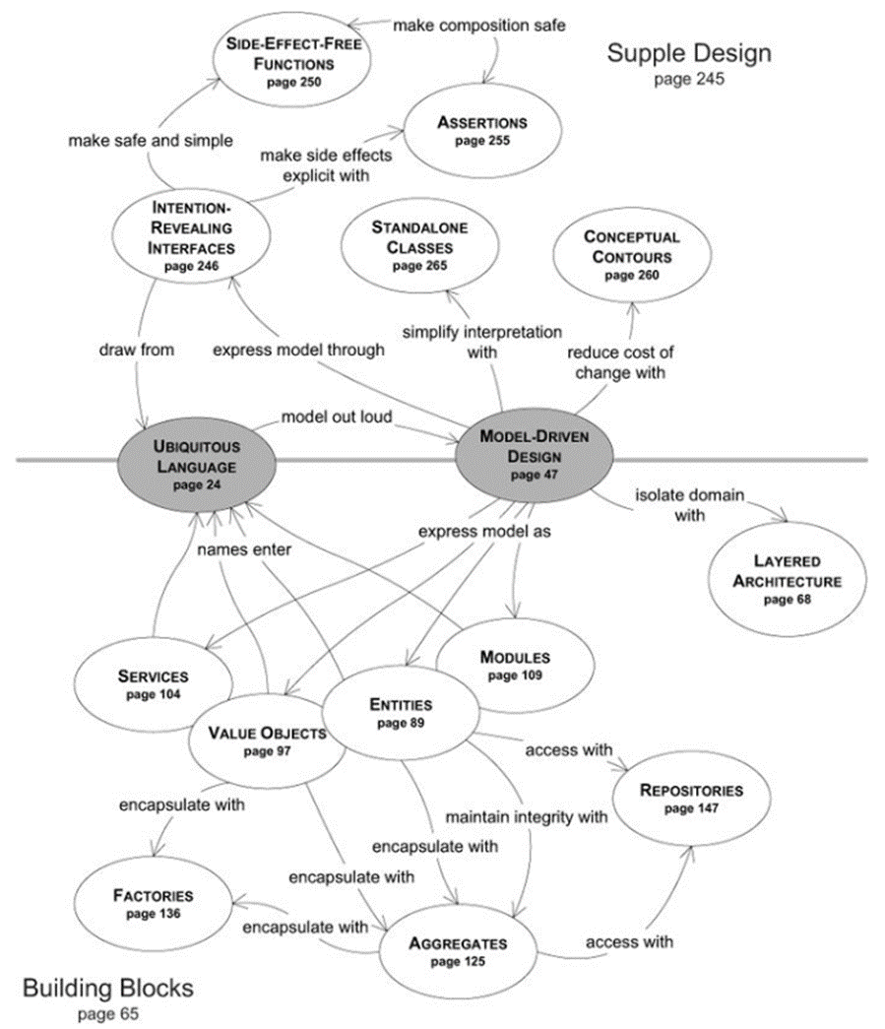
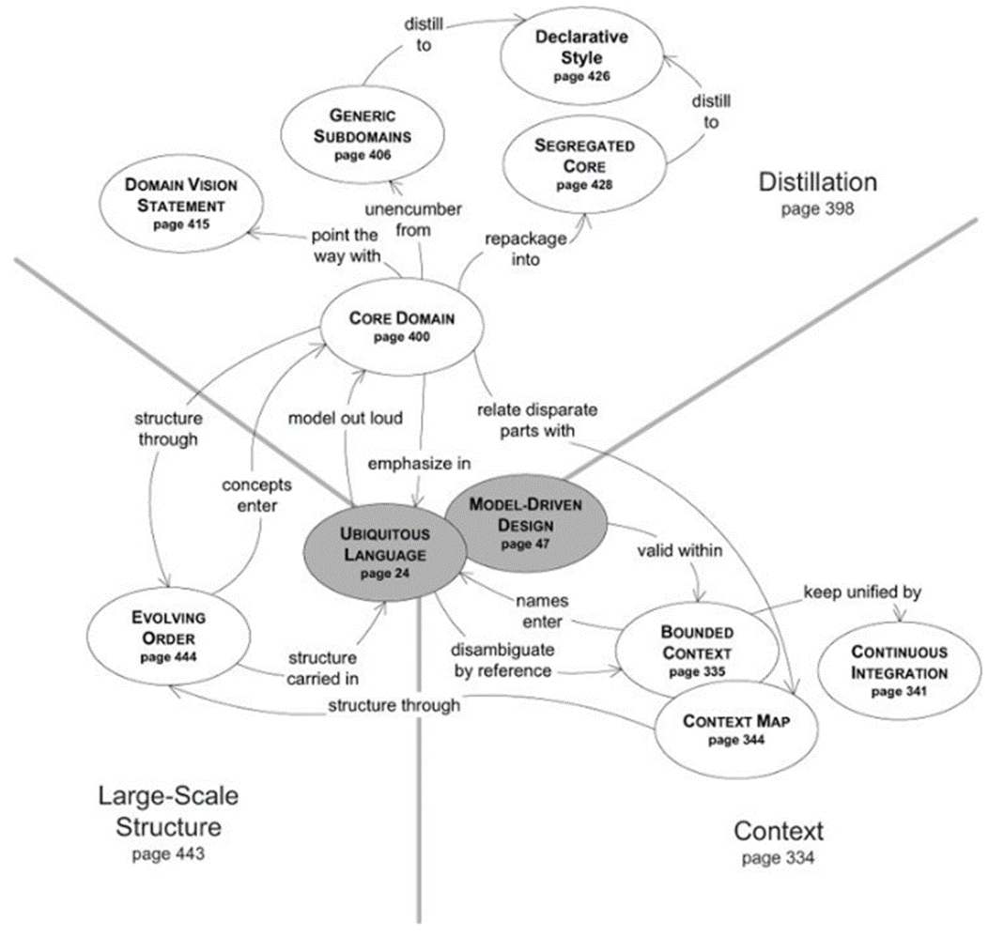

Slide 6
Ubiquitous Language
“Each resource within the RIS would have a field to assign a weighting factor for the dose information provided by that modality/equipment. The field would allow for calculation of a common factor for exposure to the patient regardless of manufacturer. In most cases this would be a simple multiplier, but in some cases would require more complex calculations. The intent is to provide a field for a physicist to add a consistent calculation that would be applied to all results received from a particular machine to normalize the data. Additional display values would also be optional to show per resource including adding the display value for CTDI, DLP, Organ Dose, Whole Body exposure, or other.”
This is the language of MY DOMAIN – Our business experts, our developers, our testers
One Team, One Language, One Model

Slide 7
Single Domain Model for Analysis and Design
Based on Ubiquitous Language
Names, Events, Relationships
Requires attention to style and self-discipline
Must do the right thing, and say the right thing
One model underlies implementation, design, team communication
The model and the design shape each other
Correspondence between model and design must be literal and exact

Slide 8
Domain Driven Design Patterns
Strategic Patterns
Domain
Core domain
Subdomain
Generic subdomain
Bounded context
Context map
Tactical Patterns
Domain Entities
Value Objects
Aggregates
Domain Services
Domain Events
Modules

Slide 9
From Bounded Context to Implementation
Bind Core Domain or Subdomain to code
Bounded Context sets scope for Ubiquitous Language
Visual Studio projects map to Bounded Context

Slide 10
A Vocabulary Scrub
A Value Object is not a value type
A Domain Entity is not an Entity Framework Entity
A Domain Service is not a web service
An Aggregate is not a form of composition

Slide 11
Domain Entities
Unique identity
Mutable
Intrinsic characteristics

Slide 12
Entities and Identity
Scope of uniqueness
Sources of identity
User
Application or persistence store
Already identified by another application or bounded context
Is identity immutable?
Compound identity
Timing of identity generation
Surrogate identity (persistence identity different from domain identity)
Identity stability

Slide 13
Discovering Entities
Ubiquitous language
Discussion, scenarios, use cases
Essential attributes
Entities change over time
Intention revealing interfaces
Prefer behavior names that reflect ubiquitous language, rather than public setter methods

Slide 14
Discovering Entities
Roles and responsibilities
Each role may be a separate entity or aggregate
Implicit role defined by class implementation
Explicit roles defined by interfaces the entity implements
Constructors provide identity and invariants
Reject undue influence of data model leakage

Slide 15
Value Objects
Measures, quantifies, describes
Not unique
Immutable
Conceptual whole – related attributes as an integral unit
Completely replaceable
Can be compared using Value equality
Provides side-effect-free behaviors
Preferable to entities

Slide 16
Immutability
Constructor call provides all attribute values
No public or hidden methods may change values
Values may be other Value Objects or Entities
If a referenced Entity changes, this violates immutability

Slide 17
Conceptual Whole
All attributes are related
Each attribute contributes to the whole of the Value
Each individual attribute, alone, has no cohesive meaning
Example: Monetary Value
Amount – numeric
Currency – string
Behaviors as well as attributes define a strong type

Slide 18
Replaceability and Equality
If an attribute value needs to change, replace with a whole new Value Object
Equality is based on type and all attributes

Slide 19
Side-Effect-Free Behavior
Value Object methods must not violate immutability
Characteristic of functional programming
Methods may produce and return new Value Objects
Characteristic of CQRS
Command-Query-Responsibility Separation
A query method asks a question to an object
Asking a question must not change the answer

Slide 20
Some Uses for Value Objects
Integrating across domain boundaries
Downstream context captures data from upstream as Value Objects (anti-corruption layer)
Static characteristic captured from other data
“User” is an aggregate, but a “Moderator” is a static role for a user
Standard Types
Phone number as “home”, “work”, “mobile”, or “other”
Currency types
Standard Types commonly reside in a separate Bounded Context from models that consume them
In native Context, Standard Types may be Entities with their own life cycle
Enumerations as State patterns and behaviors

Slide 21
Domain-Driven Testing
Testing Domain behaviors

Slide 22
Persisting Value Objects
Reject undue influence of data model leakage
Am I modeling a thing in the domain, or does it measure, quantify, or describe?
If describing an element of the domain, must this model concept possess all or most of the value characteristics outlined previously?
Am I considering the use of an Entity only because the underlying data model must store the domain model object as an entity?
Am I using an Entity because the domain model requires unique identity, I care about individual instances, and I must manage a continuity of change over the object’s life cycle?
If your answers are “Describes, Yes, Yes, and No”, use a Value Object
Persistence is about storage, not your domain model
The data model should be subordinate to the domain model

Slide 23
Aggregates
Is it just a cluster or graph of related objects?
What are the limits on size?
If one aggregate references another, can you…
Navigate deeply?
Modify other aggregates?
What about invariants and consistency?

Slide 24
Rules
Model True Invariants in Consistency Boundaries
Design Small Aggregates
Don’t Trust Every Use Case
Reference Other Aggregates by Identity
Make aggregates work together through Identity references
Model navigation
Scalability and distribution
Use Eventual Consistency Outside the Boundary
“Whose Job Is This?”

Slide 25
Reasons to Break the Rules
User Interface convenience
Lack of Technical Mechanisms
Global Transactions
Query Performance

Slide 26
So, What Does All This Mean?
Invariant: A Business rule that must always be consistent
Transactional consistency
Eventual consistency
An aggregate’s boundary is its transactional consistency boundary
Consistency outside the boundary is irrelevant to the aggregate
The Bounded Context should modify only one aggregate per transaction
Aggregates are about consistency boundaries, not object graphs

Slide 27
What Is a “Small” Aggregate?
Limited by transactional consistency
Limited by scalability and performance
Rely on lazy loading in your persistence layer
Be aware of memory constraints
Watch out for 1-to-many relationships. They grow!
Root entity and those attributes, Value Objects, and additional entities that are required for consistency
Do additional entities present consistency problems?
Are multiple users accessing the same entities at the same time?

Slide 28
How Should Aggregates Interact?
Aggregates may hold references to other aggregates
Referenced aggregate is outside consistency boundary
Only modify one aggregate within a single transaction
Referenced aggregates need eventual consistency
Use lazy loading by identity
Use repository or Domain Service to look up dependencies before invoking Aggregate behavior
Reference by identity improves scalability

Slide 29
Eventual Consistency
Evans: Any rule that spans Aggregates will not be expected to be up-to-date at all times.
Delayed consistency is common in business
Domain Events provide for asynchronous subscribers
CQRS architecture pattern supports eventual consistency
“Whose Job Is It?”
Current user – use transactional consistency
Other users, or system – use eventual consistency

Slide 30
Breaking the Rules
User Interface presents a view of concurrent changes
Batch processing of aggregates, as long as consistency matches user expectations
Lack of Technical Mechanisms
No support for messaging, timers, or threading
User-aggregate affinity
Global Transactions
Two-phase commits
Performance
Sticking to the rules will benefit your project

Slide 31
Insight Through Discovery
Rethink your design, and refactor
Estimate Aggregate cost
Design for common usage scenarios
Memory considerations
Explore alternative designs
Implement eventual consistency

Slide 32
Implementation
Root Entity with Unique Identity
Favor Value Object parts
Tell, Don’t Ask
An object should be told what to do
Law of Demeter
Any method may invoke methods only on the following
Itself
Any parameter passed to it
Any object it instantiates
Self-contained parts that it can directly address
Avoid Dependency Injection into Aggregates
Repositories
Domain Services

Slide 33
Domain Services
What a Domain Service is
Any process or transformation in the domain that is not a natural responsibility of an Entity or Value Object
Stateless
Fine grained
Clearly expressed in terms of the Ubiquitous Language
What is it not?
Service-Oriented Architecture
Remote Procedure Call
Middleware
Application Service

Slide 34
Make Sure You Need a Service
Use only if circumstances fit
Significant business process
Transform a domain object from one composition to another
Calculate a Value requiring input from more than one domain object
Consider using a Separated Interface, Dependency Inversion, or a Factory

Slide 35
Next Month
Domain Events
Repositories
Factories
Integration
Applications

Slide 36
Resources
.NET Implementation of Vaughn Vernon’s Sample Project
https://github.com/VaughnVernon/IDDD_Samples_NET/

